Slide 1
Lab 5
Ramon Lawrence
ID#: 11111111

Slide 2
Key Programming Concepts
Using memory
variables – names for data items manipulated
locations – addresses of data items in memory
values – the value stored at a location
initialization – setting initial variable values
Giving instructions
function – a named algorithm
loops/iteration – repeating a sequence of steps
assignment – changing the value of variables
decisions – changing actions based on a condition
expressions – operands/operators that yield a result

Slide 3
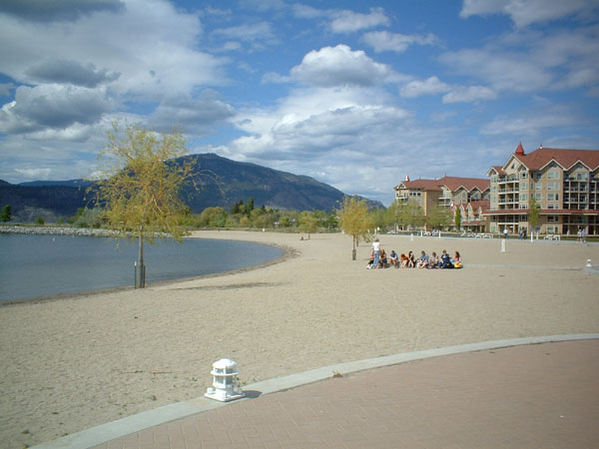
What I Like About Summer
No snow
No school
No worries
Going to the beach
Kelowna has nice beaches.

