Slide 1
3D Game Development
By Jessie Slamka
Computer Science
Honours Thesis
Supervisor: Ramon Lawrence

Slide 2
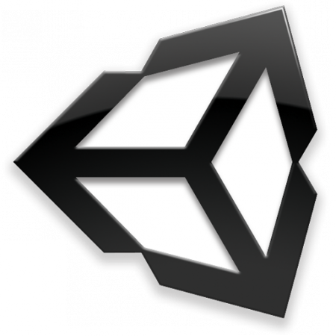
Project
To explore available freeware in the process of creating a 3D game
The game involves having the player move a chameleon through an environment in search of an antidote to the poison that makes his colour change at random and will kill him after a given time period
Programs
Blender
Unity
Notes:
I’m sure you’ve at least heard of those 3D games getting so much attention, like Assassin’s Creed, which was made by the Montreal branch of Ubisoft, and the Final Fantasy series from Square Enix, but I’m not sure you understand just how much work goes into them that justifies their price tags. I’m going to give you a glimpse of the effort that goes into making them look as good as they do.
Click to bring up game description
Professionals use in-house or commercial tools. I’ll be showing you how far you can get with freeware.

Slide 3
Overview
Game Development consists of six stages:
Conception
Design
This is where goals, re-playability, and obstacles are decided upon
Modelling
This is where rules and player controls are established and concept art is created
Animating
This is where the game elements are built and rigged
Scripting
This is where character motions are created
Testing
This is where all game elements are brought together and code is written to define their interactions
This is where the product is tested and retested

Slide 4
Conception
Three aspects are required in making a good game:
Goal
To have the chameleon find the antidote
Obstacles
Snakes, which can kill the chameleon
Terrain, which hides the antidote
Gravity, which can cause the chameleon to die if he falls from a great height
Re-playability
Randomly placed elements
Antidote (fruit)
Snakes
Chameleon

Slide 5
Game Rules
Player may move anywhere within the playing field, be it on the ground, on trees, rocks, or bushes, but not in deep water
Player wins when the chameleon touches the antidote.
Player loses the round when the chameleon is hit by a snake, falls from a tree and reaches terminal velocity before landing on the ground, or goes into deep water

Slide 6
Front View of Veiled Chameleon
Used as a reference for the head and the width of the upper thoracic cavity.

Slide 7
Side View of Veiled Chameleon
This was the primary reference photo used to model the chameleon.

Slide 8
Underside of Veiled Chameleon
Used as reference for hands and the shape of the neck and belly.

Slide 9
Modelling
This was done in Blender
Modelling is the process of creating a 3D mesh representation of the game elements. The following strategies were used
Extrusion Modelling
Subdivision Modelling
Rigging, a subtask specific to animated meshes, was also done during this phase.

Slide 10
A Quick Introduction to 3D Modelling
Notes:
In mesh editing, we can work on three levels: vertices, edges, and faces.
Faces are the meat of a mesh, the visible part. They are defined by three or four edges (three or four vertices).
As with edges, these can be rotated, scaled, and translated.

Slide 11
Tree Combining Two Strategies
Notes:
This involves taking the faces of a primitive shape like a cube and extruding them and reshaping their vertices through translating, rotating, and scaling.
This was primarily used on the trees, though it was used to a degree on the chameleon, primarily in modelling his tail and blocking out his initial shape.
This involves cutting/subdividing the faces and edges of a primitive.
This was primarily done in creating the chameleon (adding details to his blocked out shape) and in adding subsections to the snake so his mesh would be able to curve properly.
The best way to go is to use the extrusion strategy, at least initially. In this way, blocking out the basics of the shape is easily done.
Later on, cutting up faces and subdividing them is useful in creating details, such as adding a more rounded shape to eyes and noses as well as any limbs.

Slide 12
Rigging
This is the process of adding a skeleton to the mesh
There are three primary steps:
Building a skeleton by extruding bones from the base bone
Adding constraints to the bones
Weight Painting the mesh to the bones
Notes:
Bones are added to a skeleton by extruding them from their parent bone.
Bones generally exist in hierarchical chains
The shoulder is the parent of the upper arm bone, which is the parent of the forearm bone, which is the parent of the hand bone, and so on.
The parent-child relationship between bones is the primary constraint, but occasionally more are needed.
I used
Inverse Kinematic constraints
Floor constraints
Stretch To constraints

Slide 13
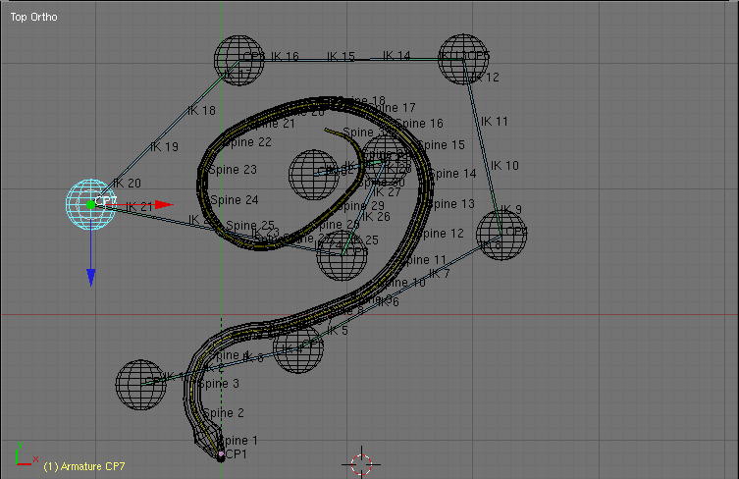
Snake Rigging
Notes:
Talk about how not all bones are used to deform the mesh; instead they are used to manipulate other bones that are controlling the mesh.

Slide 14
Animating
This was done in Blender
Game animation is different from animation done for film
Animations must be short and built so they can be replayed in a loop if necessary
Because animations can be played in layers, gestures like a tail curl or an arm movement can be separate animations
Animating involves building the specific motions by manipulating the skeleton and recording keyframes
Notes:
No clicks here.
For example, a walk cycle must start with one leg and end with the body in position to move that leg again.
This is the process of moving the bones.
First, major motions are blocked out
Feet and hands and moved to where they should be at the appropriate time, and keyframes are added.
Minor motions are then added in
The motion of elbows and knees and spine because of the motions of the hands and feet are added.

Slide 15
Editing the Chameleon’s Walk

Slide 16
Chameleon Motions
Walk cycle

Slide 17
Snake Motion
Snake Slither

Slide 18
Scripting
This is where Unity comes in
All game elements are imported and handled by Unity, which is the platform of the actual game building
Scripting involves assembling pieces of code that will enforce game logic on elements such as meshes, animations, sounds, and game screens
Notes:
No mouse clicks on this page

Slide 19
Walkthrough
Notes:
30 seconds

Slide 20
Conclusion
Blender
Version 2.49b has some small issues, but 2.5 looks like it will be a tool as useful as commercial software
Unity
Has a great user interface and is a powerful game building platform, but could use some work on stability, mesh importing, and documentation
Notes:
Blender
Does not support spline modelling
User interface is not the best (often confusing), especially when working with textures
Steep learning curve because of keyboard shortcut dependence, but this causes increased efficiency later because users are not constantly hunting with a mouse to change from the rotation to scaling or translating tools.
In perspective view, there is a limit to the zoom before the increments it zooms in for every button push becomes useless
Unity
Will need some work yet. As it just recently released a free version that has already gone through four updates in the five months that I worked with it, it is likely that it will improve rapidly
Until then, I will be looking into an alternative

Slide 21
Future Work
Improving snake’s animation on terrain
Creating AI for the snake
Improving camera functionality
Detecting terminal velocity when chameleon is falling and when the chameleon has gone into deep water
Texturing trees and snakes.

Slide 22
Timeline
Notes:
Use bar chart. Person hours.

